Slide 1
Azure Governance and Deployment Customer Call
February 2022

Slide 2
Agenda
New releases
Seeking feedback on roadmap items
Q&A

Slide 3
New releases

Slide 4
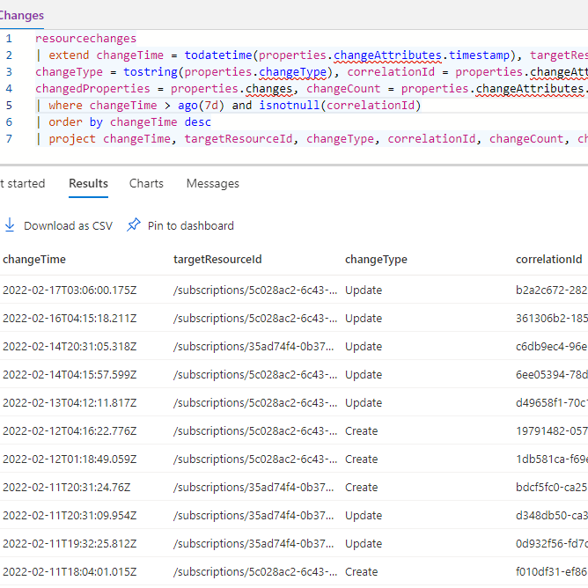
Resource configuration changes
Public preview
Query changes across your subscriptions and tenants using Azure Resource Graph
Last 7 days of changes
Available in under 5 minutes
https://aka.ms/resourceConfigurationChanges

Slide 5
Demo
Jenny Hunter

Slide 6
Seeking feedback on roadmap items

Slide 7
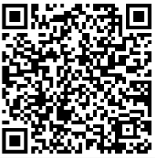
Azure Policy Investment Discussions
Sign up to participate in a 30-min call to discuss upcoming Azure Policy investments:
Resource type dependencies in policy
Enhancements to the user’s private catalog by enabling policy to allow/deny resource types & their respective dependencies.
Policy roll out and versioning
Advancement of our Policy-as-code experience by allowing for a gradual lifecycle of policy resources.
Policy portal experience and documentation
Improvements to the onboarding and day-to-day experiences with Azure Policy through portal and documentation.
aka.ms/policy-discussion-sign-up
Notes:
- We’re considering enhancements to the user’s private catalog by enabling policy to allow/deny resource types & their respective dependencies. If your organization is interested in discussing the way dependencies should be expressed in policy, and/or use any policy relating to allowed or disallowed resource types (example) at the root MG or high-scoped MG level today, we’d love to chat—please sign up above.

Slide 8
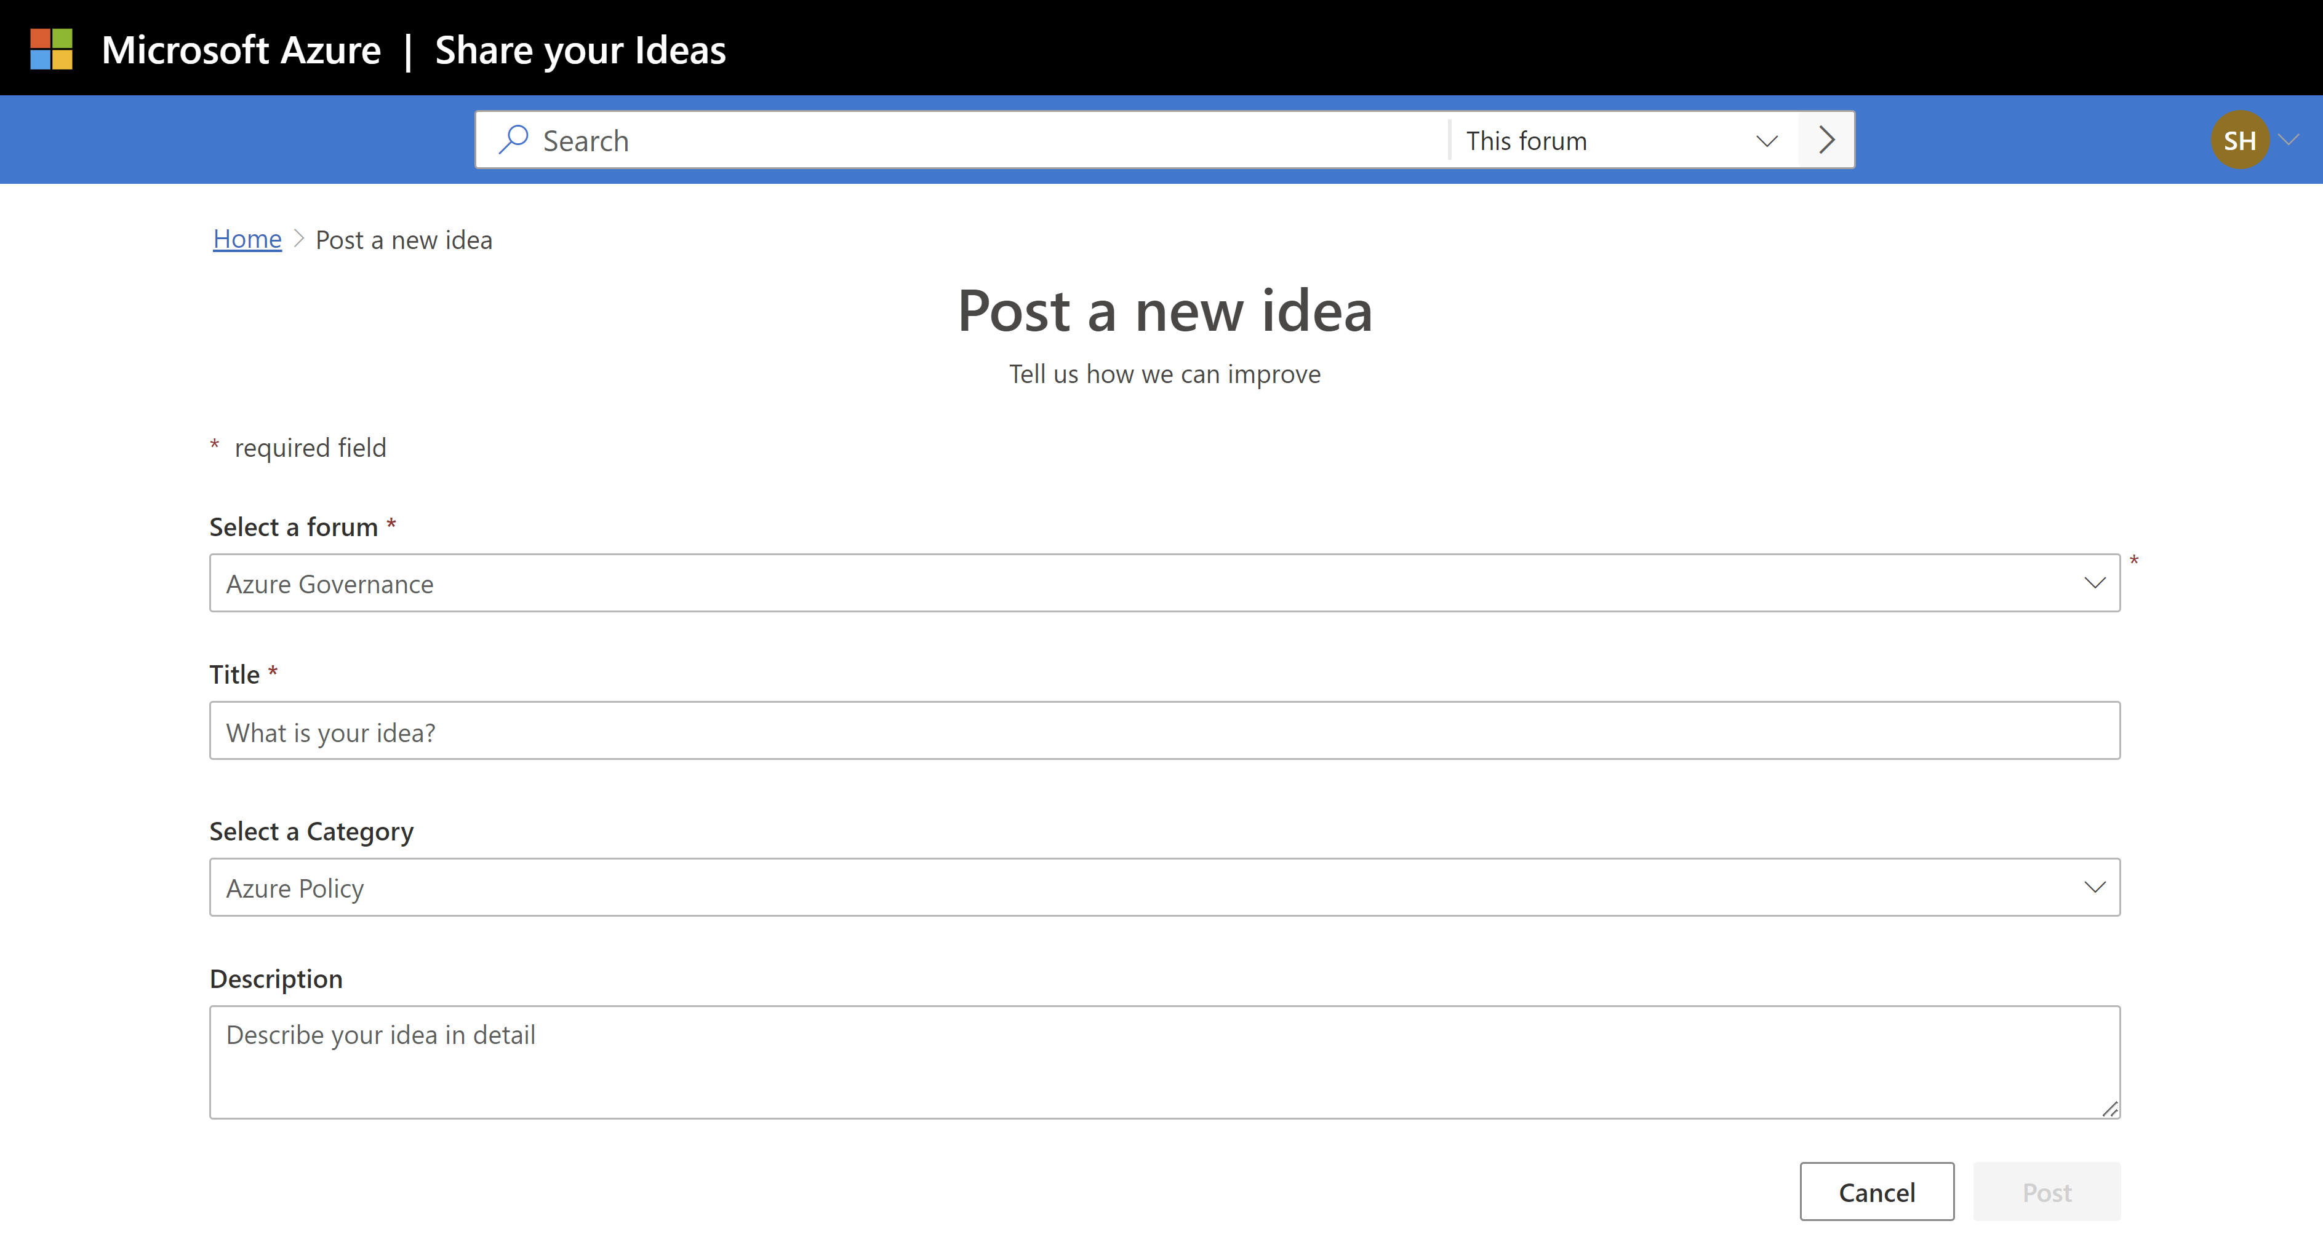
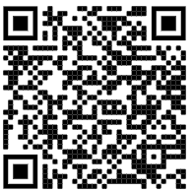
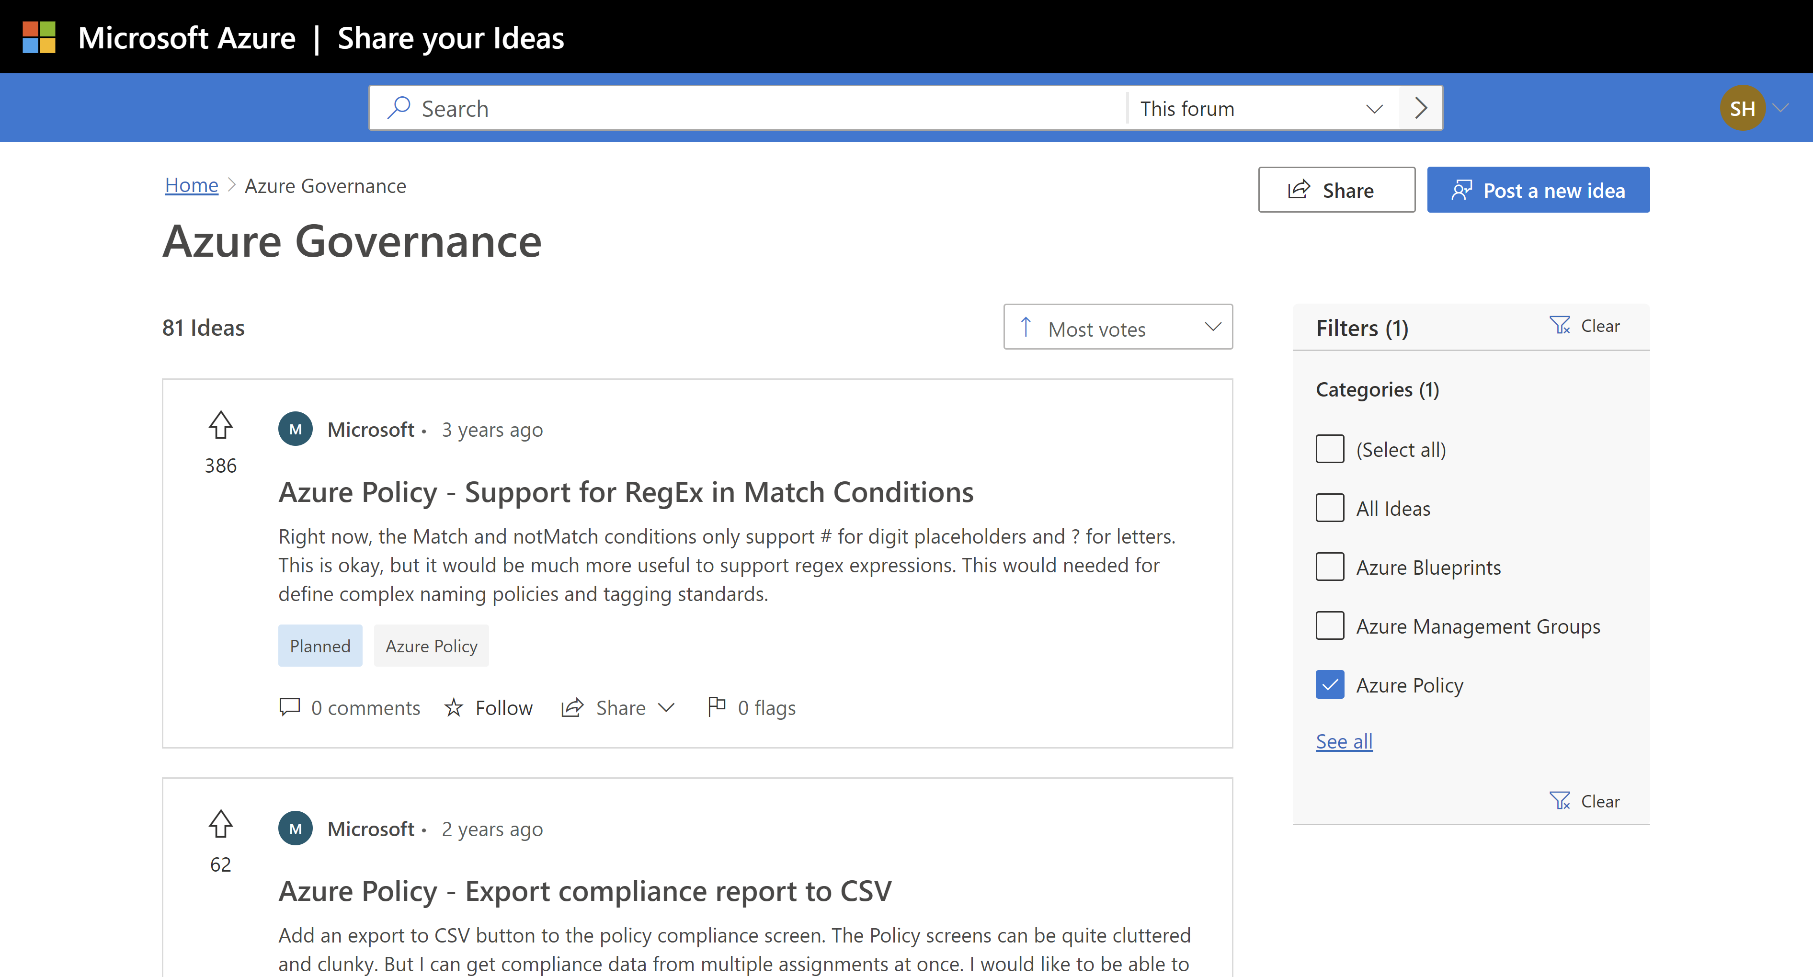
Have ideas for Azure Policy?
View, vote on, and post feature requests at aka.ms/az-gov-feedback
Forum > Azure Governance
Category > Azure Policy

Slide 9
Safe deployment process of Policy resources
Create
Update
Rollback
Deprecate
Control the enforcement of assignments on existing environments in a least to most impactful manner.
Allow for gradual rollout of changes to policy resources in existing environments.
Maintain a push back process for any changes that might warrant a revert.
Remove any policy resource or assignment parameters that are no longer applicable.

Slide 10
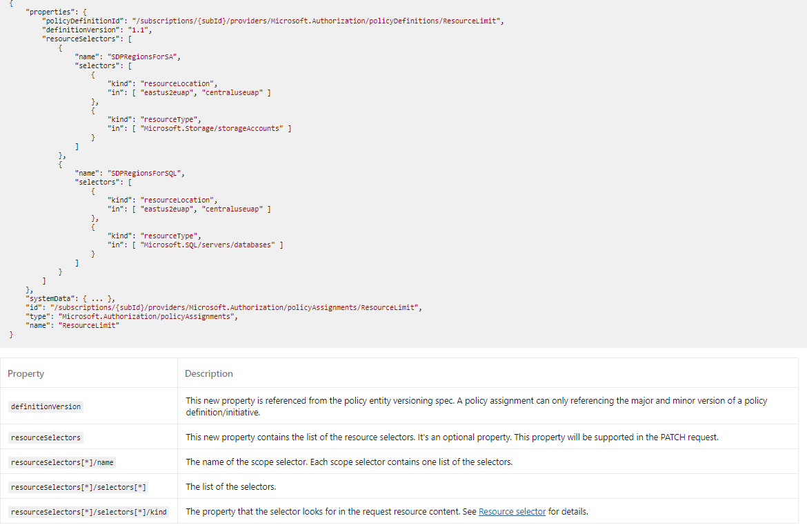
Selectors
New property “resourceSelectors” in assignments and exemptions
Specify location or type of resource to evaluate
Specify definition version or policyDefinitionReferenceIDs for policySet

Slide 11
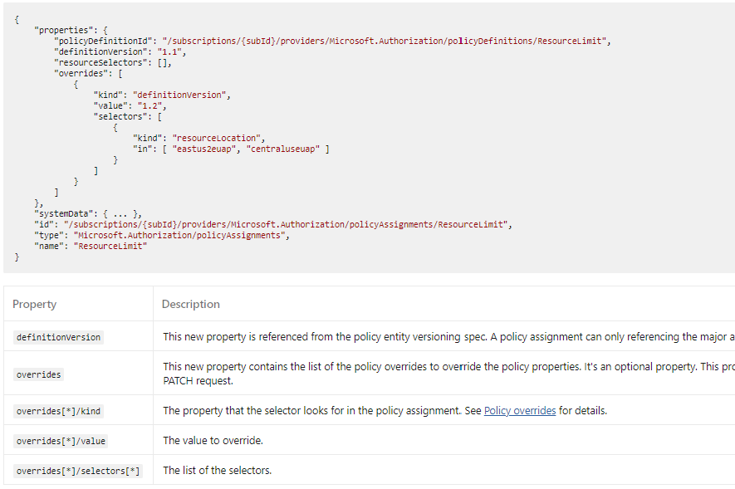
Overrides
New property “overrides” in policy assignments ONLY
Specify definition version or policy effect
Can have selectors within overrides

Slide 12
Safe deployment process of Policy resources
Create
Update
Rollback
Deprecate
Control the enforcement of assignments on existing environments in a least to most impactful manner.
Allow for gradual rollout of changes to policy resources in existing environments.
Maintain a push back process for any changes that might warrant a revert.
Remove any policy resource or assignment parameters that are no longer applicable.

Slide 13
Safe deployment process of Policy resources
Create
{
"properties": {
"policyDefinitionId":"/subscriptions/subId/providers/Microsoft.Authorization/policySetDefinitions/SecureKV",
"definitionVersion": "1.0.0",
"resourceSelectors": [ {
"name": "SDPRegions",
"selectors": [ {
"kind": "resourceLocation",
"in": [ "eastus2euap"]
}]
} ]},
"id": "/subscriptions/{subId}/providers/Microsoft.Authorization/policyAssignments/SecureKV",
"type": "Microsoft.Authorization/policyAssignments",
"name": “SecureKV "
}
Update
Rollback
Deprecate
Create definition
Create policySet
Create assignment
Roll out
Allow for gradual rollout of changes to policy resources in existing environments.
Maintain a push back process for any changes that might warrant a revert.
Remove any policy resource or parameters that are no longer applicable.

Slide 14
Safe deployment process of Policy resources
Create
Update
Rollback
Deprecate
Control the enforcement of assignments on existing environments in a least to most impactful manner.
Allow for gradual rollout of changes to policy resources in existing environments.
Maintain a push back process for any changes that might warrant a revert.
Remove any policy resource or assignment parameters that are no longer applicable.

Slide 15
Safe deployment process of Policy resources
Update
Update
Rollback
Deprecate
{
"properties": {
"policyDefinitionId":"/subscriptions/{subId}/providers/Microsoft.Authorization/policySetDefinitions/SecureKV",
"definitionVersion": “1.0.0",
"resourceSelectors": [ {
"name": "SDPRegions",
"selectors": [ {
"kind": "resourceLocation",
"in": [ "eastus2euap", "centraluseuap" ]
}]
} ],
“overrides”:[{
{
"kind": "definitionVersion",
"value": “2.0",
"selectors": [{
"kind": "resourceLocation",
"in": [ "eastus2euap"]
}]
}
}]
}"id": "/subscriptions/{subId}/providers/Microsoft.Authorization/policyAssignments/SecureKV",
"type": "Microsoft.Authorization/policyAssignments",
"name": “SecureKV"
}
Update definition
Update policySet
Update assignment
Roll out using overrides
Update property
Allow for gradual rollout of changes to policy resources in existing environments.
Maintain a push back process for any changes that might warrant a revert.
Remove any policy resource or parameters that are no longer applicable.

Slide 16

Q+A

